Slide 1
Face Authentication based Attendance System
Name :- Piyush Kumar
Entry Number :- 23bcs061
Semester:-5th
Department:-Computer science engineering
Guide Name:-Dr. Rohit Tanwar sir

Slide 2
Problem Statement
Develop a facial authentication based attendance system that records attendance in a CSV file and sends email for attendance confirmations to ensure accurate, efficient , and paperless attendance management.
Objectives
The main objective of this project is to overcome Traditional attendance systems that rely on manual entry or physical identification. By developing a facial recognition-based attendance management system that can detect and identify faces in real-time, and mark the attendance in a CSV file also send email for attendance confirmation to ensure accuracy, security, time efficiency, and prevention of proxy attendance.
.

Slide 3
Proposed Methodology
Image Acquisition:
Capture student images through a webcam in real-time.
Grayscale Conversion:
Converts RGB image to grayscale to reduce computational complexity while retaining
important features.
Face Detection:
Use algorithms like Haar Cascade detectors to locate faces in the frame.
Feature Extraction:
Extract face data from resized images and store it in a pickle file.

Slide 4
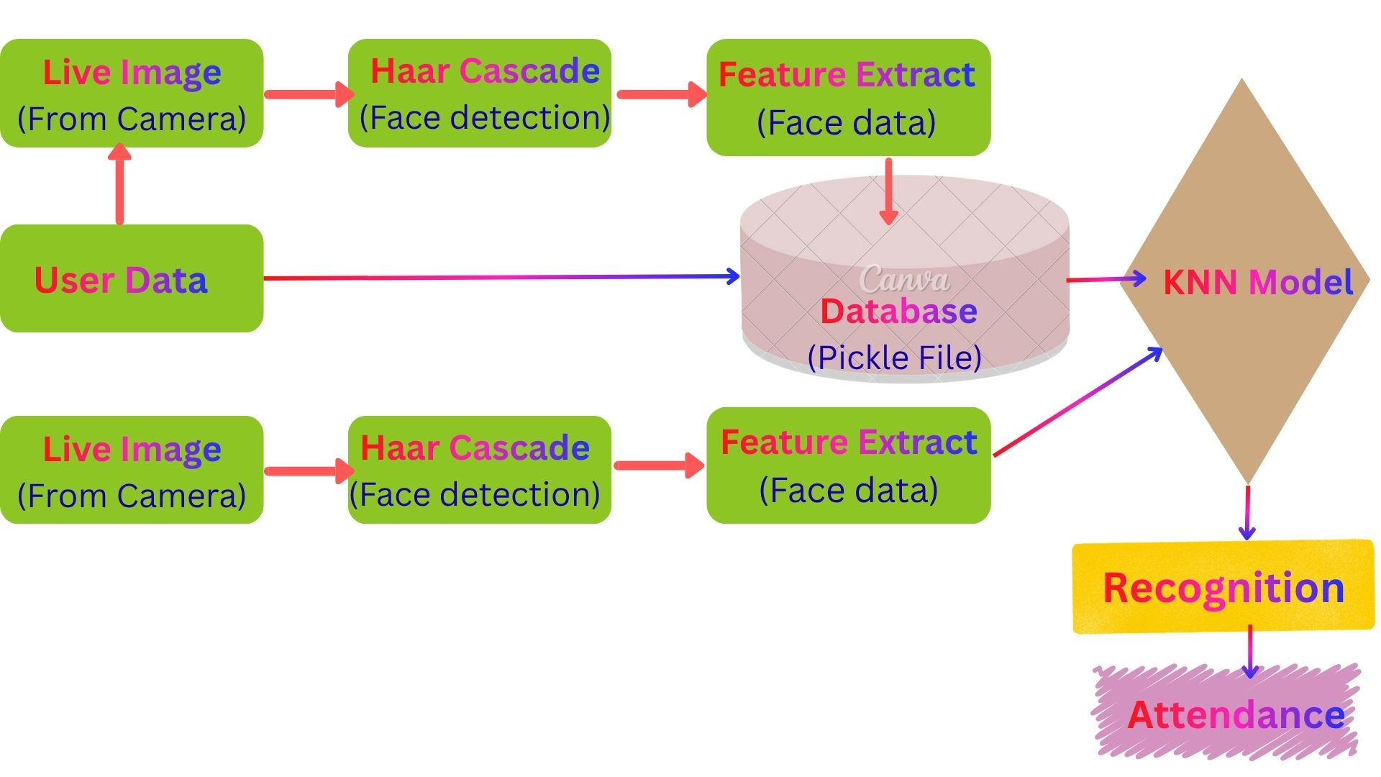
Model Training and prediction:
For this purpose I use KNN algorithm to train the model. And use it to predict incoming
frame with the help of this trained model.
Attendance marking and Confirmation:
If authentication succeeds, it mark the attendance in the system as CSV file.
And send email for attendance confirmation.

Slide 5
Technologies and Tools used
A. Programming Language:
1. Python: Most commonly used language for computer vision and machine learning
tasks.
B. Libraries and Modules:
1.OpenCV: An open-source computer vision library often used for image processing and face detection tasks.
2.pickle: pickle is a standard Python module for serializing and deserializing Python objects.
3. OS: The OS module provides a way to interact with the operating system.
4.numpy: numpy is a fundamental package for numerical computing in Python.
5. Scikit-learn: Scikit-learn is also an open-source Python library usually used for machine learning task for providing algorithms to train and predict the model like KNN.

Slide 6
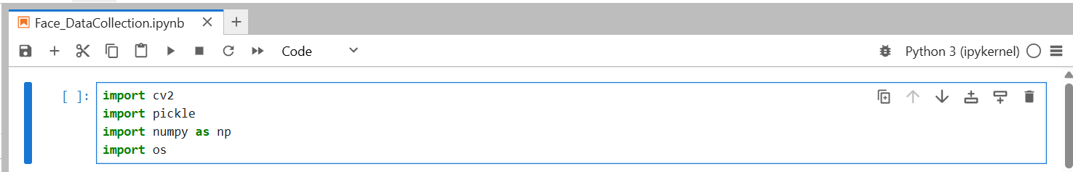
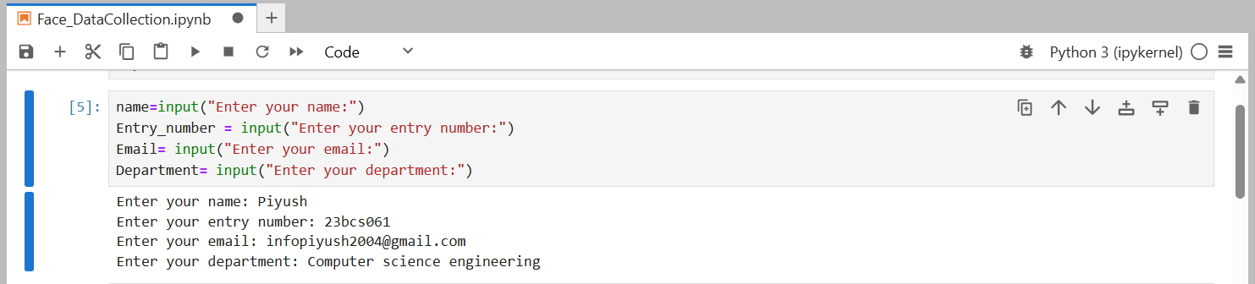
Work Done /Progress
I have imported all necessary libraries and modules.
Here I am collecting all necessary data from the users.

Slide 7
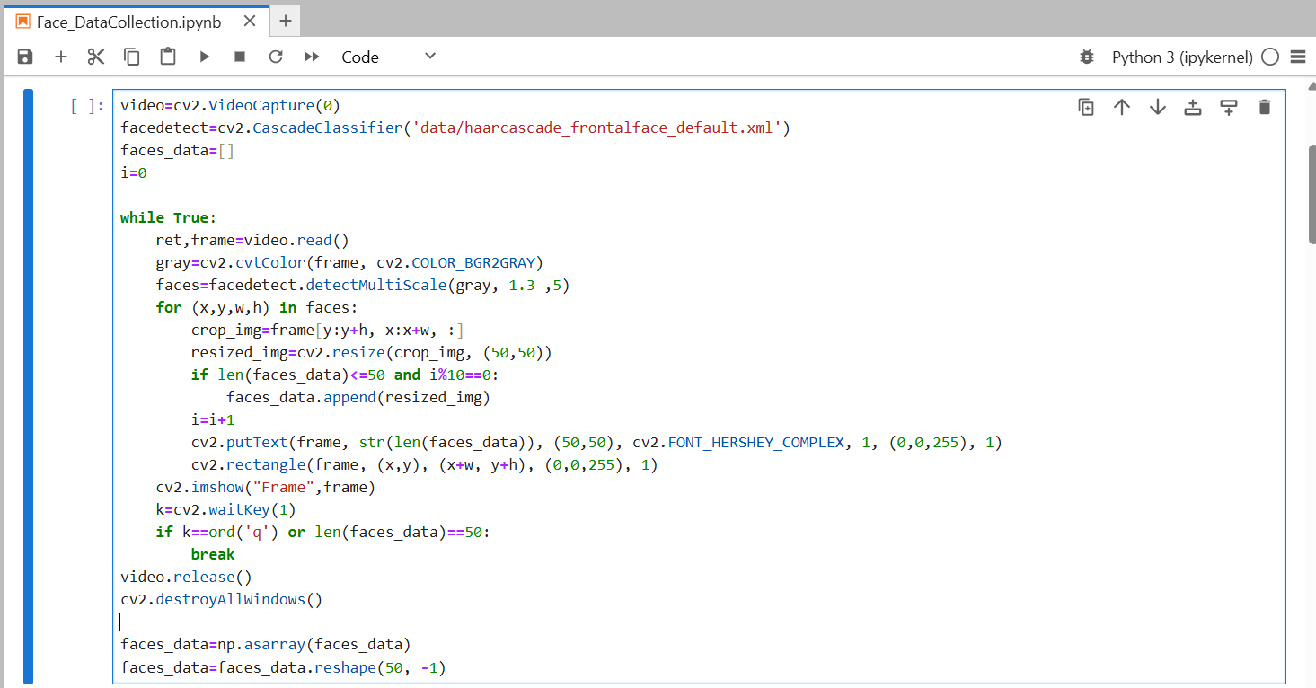
Code snippets for Collecting Face data of the users.

Slide 8
Here, I have used the Haar Cascade classifier for face detection with the help of the
pre-trained classifier file “haarcascade_frontalface_default.xml’’ . The classifier is
trained with many positive images (with objects) and negative images (without objects).
With the help of the detectMultiScale() function, we find four parameters: ‘x’ and ‘y’, which are the coordinates of the upper-left corner and ‘w’ and ‘h’, are the width and height of the detected face in the frame.
Draws a rectangle around detected face, using the coordinates (x, y) (upper-left corner) and (x+w,y+h) (lower-right corner).
Draws the number of detected faces as text on the frame at position (50, 50).

Slide 9
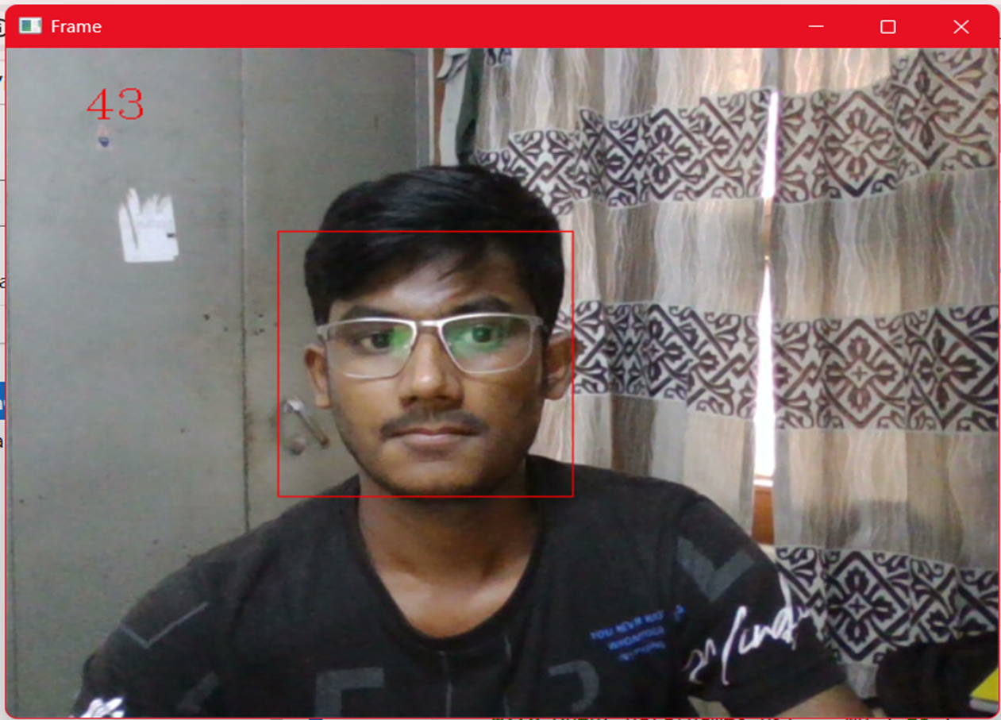
Here I am detecting face of the users.

Slide 10
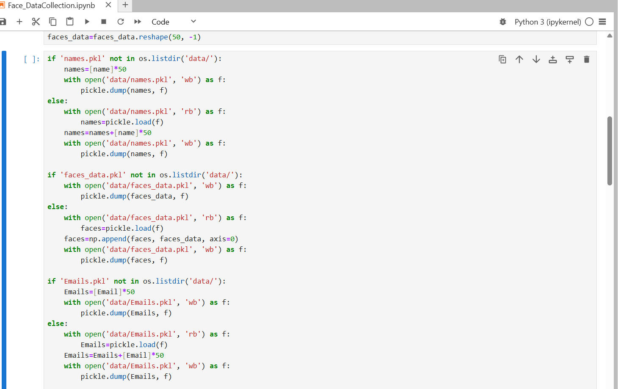

Slide 11
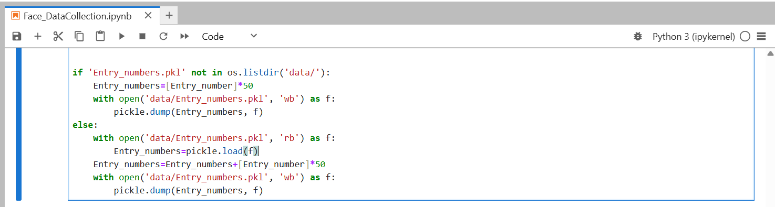
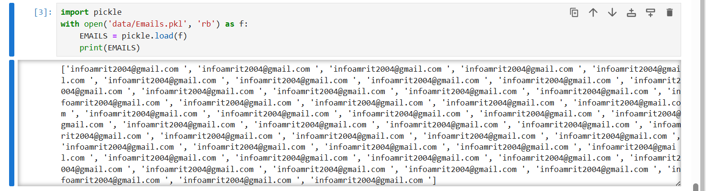
Here I am storing all collated data from users in pickle file..

Slide 12
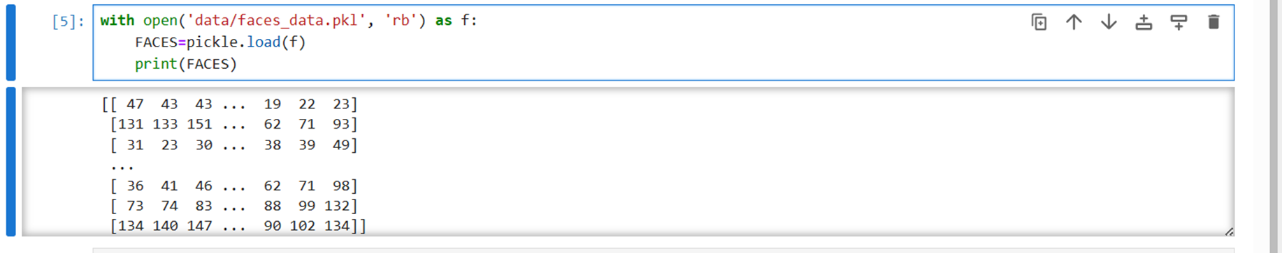
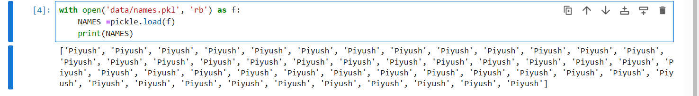
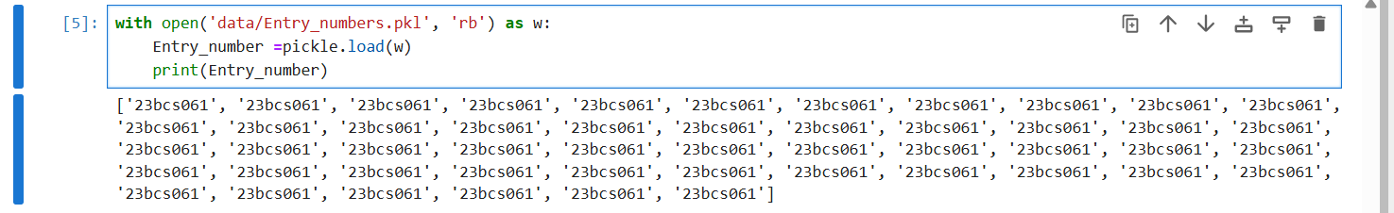
Data store inside the pickle file.

Slide 13
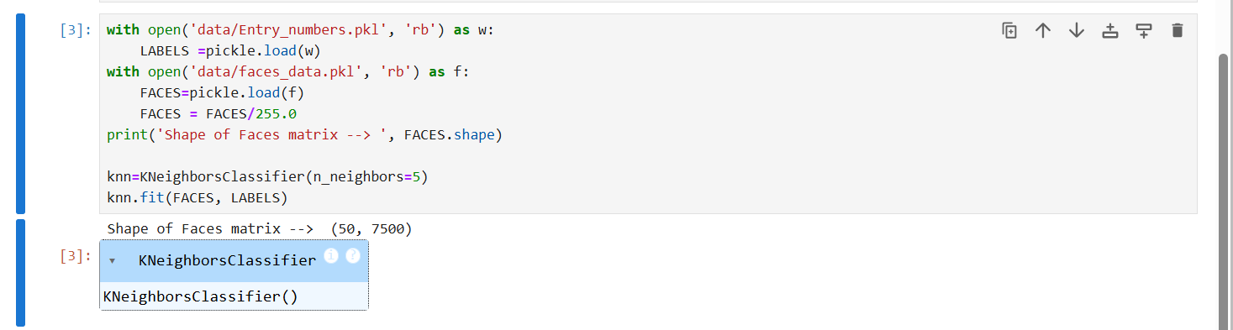
Training Model
Imported all necessary libraries and modules along with KNN.
Here, I use face data as training data and entry numbers as labels to train the KNN model.
This means FACES contains the normalized face image data (features), and LABELS
contains the corresponding entry numbers (class labels).

Slide 14
Future work
Till now, I have completed two steps: the first one is feature extraction, and the second one is training the machine learning model.
Third step is to recognize (identify) the incoming face using the data from the trained model.
Fourth step is to mark attendance and send email to the user for Attendance
confirmation.
Fifth step is to create an interactive GUI to handle all tasks. Like Face Registration,
Take Attendance and View Attendance.
How I overcome challenges ?
I use Google, YouTube videos, and blogs related to computer vision and face
recognition for handling challenges.

Slide 15
Conclusion
Finally , I have detected the face of the user and extracted data from each faces .and storing all necessary user information including faces data.
Again, I use these collected data to train the machine learning algorithm (KNN).
So that the model can predict accurately and recognize incoming image.
References
https://www.geeksforgeeks.org/python/face-detection-using-cascade-classifier-using-opencv-python/
https://thepythoncode.com/article/create-a-facial-recognition-system-in-python

Slide 16
Thankyou…….

